Slide 1
DBMS Deadlock

Slide 2
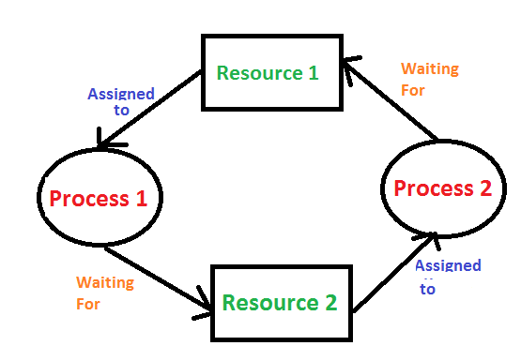

Slide 3
A system is said to be in a state of deadlock if there exists a set of transactions such that every transaction in set is waiting for another transaction to complete its execution.

Slide 4
T1
Read(X)
Write (X)
Read(Y)
Write (Y)
T2
Read(Y)
Write (Y)
Read(X)
Write (X)

Slide 5
T1 | T2
Lock X(x)
Read(X)
Write (X)
 | Lock X(Y)
 | Read(Y)
 | Write (Y)
Lock X(Y) |  | Wait for transaction T2 to unlock Y
Read(Y)
Write (Y)
 | Lock X(x) | Wait for transaction T1 to unlock X
 | Read(X)
 | Write (X)

Slide 6
Handle the deadlock
Deadlock Prevention
Deadlock detection and recovery

Slide 7
Approaches for deadlock prevention
Approach 1
A transaction acquires lock on all data items which will be required by transaction at the start of execution.
Other transactions cant hold lock on those data items till first unlocks data items.

Slide 8
Approach 2
This approach uses time stamp ordering of data items.
Every transaction can access data item in given sequence only.
TS(Ti)<TS(Tj)
Finish (Ti)< start (Tj)

Slide 9
Approach 3
Wait die
Wound die

Slide 10
Wait die
Non pre-emptive techniques of deadlock prevention
When transaction Ti wants to hold data item currently hold by Tj then Ti is allowed to wait if and only if it is older than Tj otherwise Ti is rolled back. (die)
If T1 request for data item hold by T2 then as TS(T1)<TS(T2) so T1 should wait.

Slide 11
Wound die
Preemptive technique of deadlock prevention.
When transaction Ti wants to hold data item currently hold by Tj then Ti is allowed to wait if and only if Ti is younger to Tj otherwise Tj is rolled back. (wounded)

Slide 12
T1, T2,T3
If T1 request for data item hold by T2 then data item is preempted from T2 and given to T1 and T2 is rollback
If T3 request for data item hold by T2 then T3 need to roll back.

Slide 13
Dead lock Detection and Recovery
In a database, when a transaction waits indefinitely to obtain a lock, then the DBMS should detect whether the transaction is involved in a deadlock or not.
The lock manager maintains a Wait for the graph to detect the deadlock cycle in the database.
Deadlock can be detected using directed graph called wait for graph.

Slide 14
Wait for Graph
This is the suitable method for deadlock detection. In this method, a graph is created based on the transaction and their lock. If the created graph has a cycle or closed loop, then there is a deadlock.
The wait for the graph is maintained by the system for every transaction which is waiting for some data held by the others. The system keeps checking the graph if there is any cycle in the graph.

Slide 15
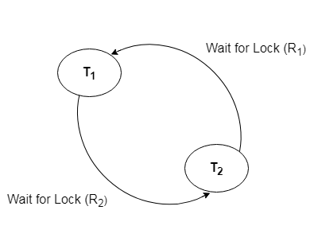

Slide 16
Recovery from Deadlock
Methods
Selection of victims
Rollback
Starvation

Slide 17
Selection of victim
If deadlock is detected then one or more transactions (victims) to be selected to break the deadlock.

Slide 18
Rollback
Total rollback: the transaction is aborted and then restart.
Partial rollback: rollback the only transaction which is needed to break the deadlock.

Slide 19
starvation
It may happen that same transaction is selected as victim and it may lead to starvation of that transaction.
System should take care that every time same transaction should not be selected as victim. So it will not be starved.

Slide 20
Thank you !

